Slide 1

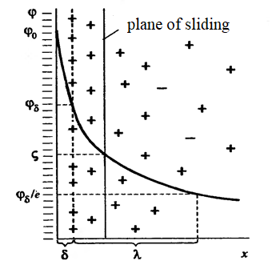
Lecture 10. Electrokinetic phenomena. Electrokinetic potential. Electrophoresis. Medical application.
Adilbekova A.O

Slide 2
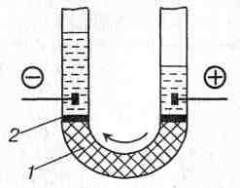
Electroosmosis
Professor F.Reuss, 1807
1 – quartz, 2 - water

Slide 3
Helmholtz - Smoluchowski
ζ = η ⋅υ⋅æ / (ε⋅ε₀⋅ I) .
I - current strength; æ – electric conductivity; bulk rate(υ, м³/с); η - dispersion medium viscosity; ε - dispersion medium dielectrical permittivity; ε₀ – electric constant 8,85⋅10⁻¹² F/m
.

Slide 4
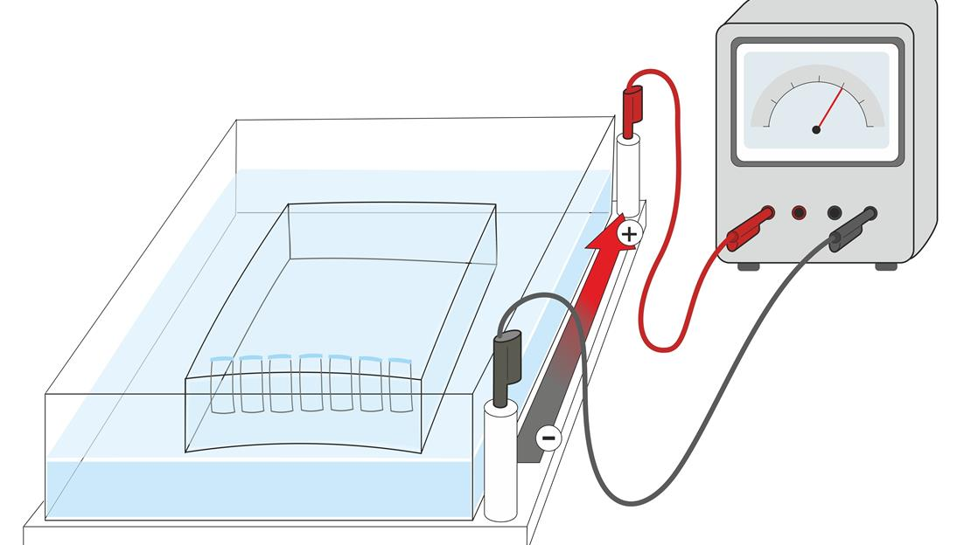
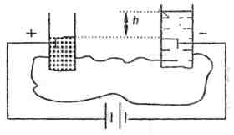
Electrophoresis.

Slide 5
Helmholtz – Smoluchowski equation
ζ = η⋅Uэф / (ε⋅ε₀ )
Uэф = u₀ / Н.
Н = Е / L (Е – potential difference between electrodes; L- distance between electrodes).
ζ = η⋅ u₀ ⋅L / (E⋅ε⋅ε₀ ) .

Slide 6
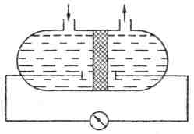
Streaming potential
(Quincke effect)
ζ = η⋅Ustream ⋅æ / (ε⋅ε₀⋅Δ p).

Slide 7
Streaming potential is reverse to osmosis.
Streaming potential occurs at electrodes placed at two sides of semipermeable membrane (diafragm) at flow of liquid.
ζ = η⋅Ustream⋅æ / (ε⋅ε₀⋅Δ p)
where Δp – presuare difference at diafragme two sides.

Slide 8

Sedimentation potential (Dorn effect)

Slide 9
Sedimentation potential is reverse to electrophoresis
ζ = 3⋅η⋅æ⋅Usedimentation / [4⋅π⋅ε⋅ε₀⋅ r³⋅ (ρ -ρ₀)⋅ g⋅ν⋅L.
where η - viscosity of dispersion medium;
æ – dispersion medium specific electroconductivity;
r – radius of dispersed particles ;
ρ and ρ0 – densities of dispersed phase and dispersion medium;
ν - particle concentration of dispersed phase;
L – distance between electrodes.

Slide 10
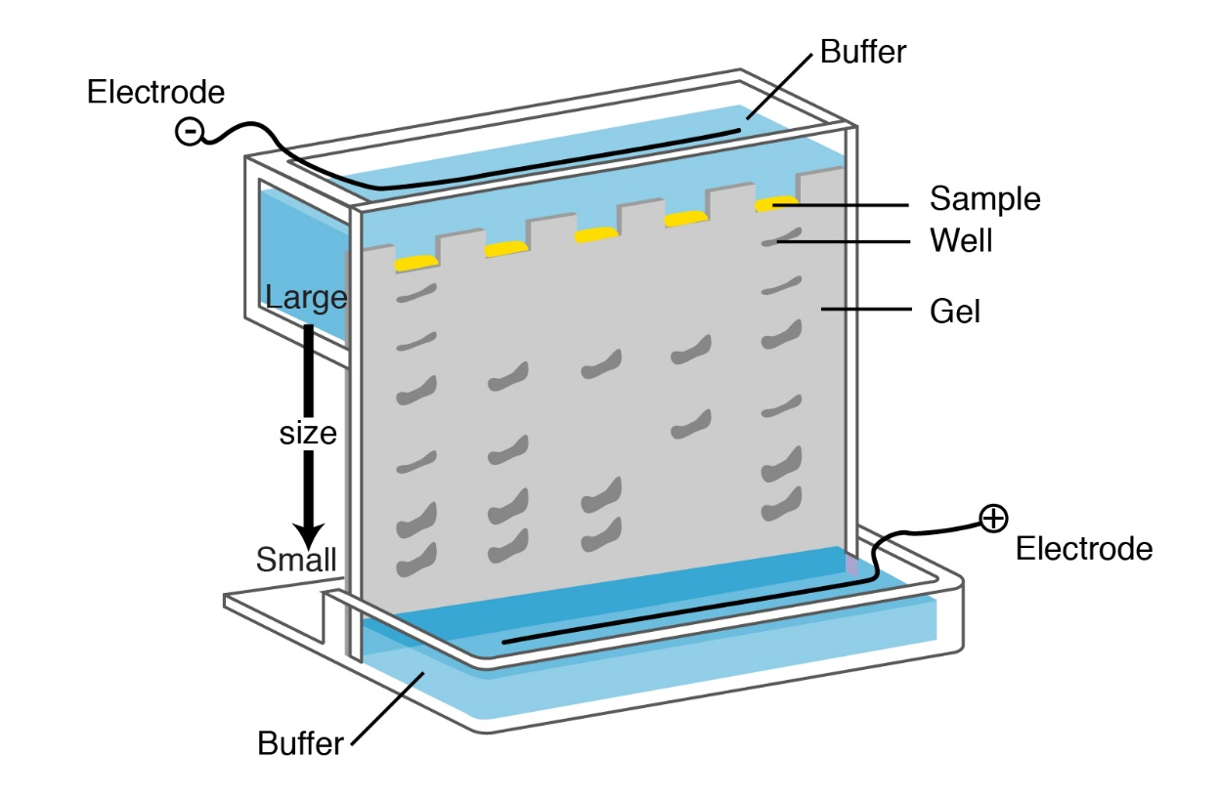
https://www.genome.gov/genetics-glossary/Electrophoresis
Electrophoresis is a laboratory technique used to separate DNA, RNA, or protein molecules based on their size and electrical charge.
An electric current is used to move molecules to be separated through a gel.
Pores in the gel work like a sieve, allowing smaller molecules to move faster than larger molecules.
The conditions used during electrophoresis can be adjusted to separate molecules in a desired size range.

Slide 11

Thank you for your attention!

